Slide 1
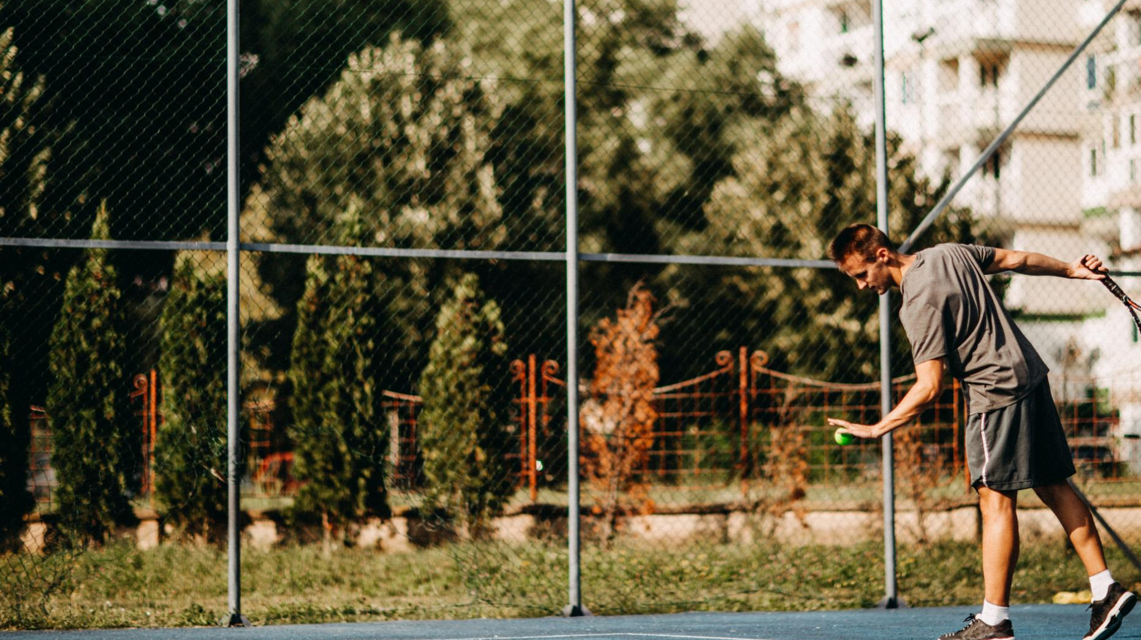
Qatar National Sports Day: Celebrating Health and Fitness
Promoting well-being through community sports activities
Notes:
---
Qatar National Sports Day is a significant annual event that promotes health and fitness among the citizens and residents of Qatar. This presentation will provide insights into its origins, activities, community engagement, societal impact, and future prospects.

Slide 2
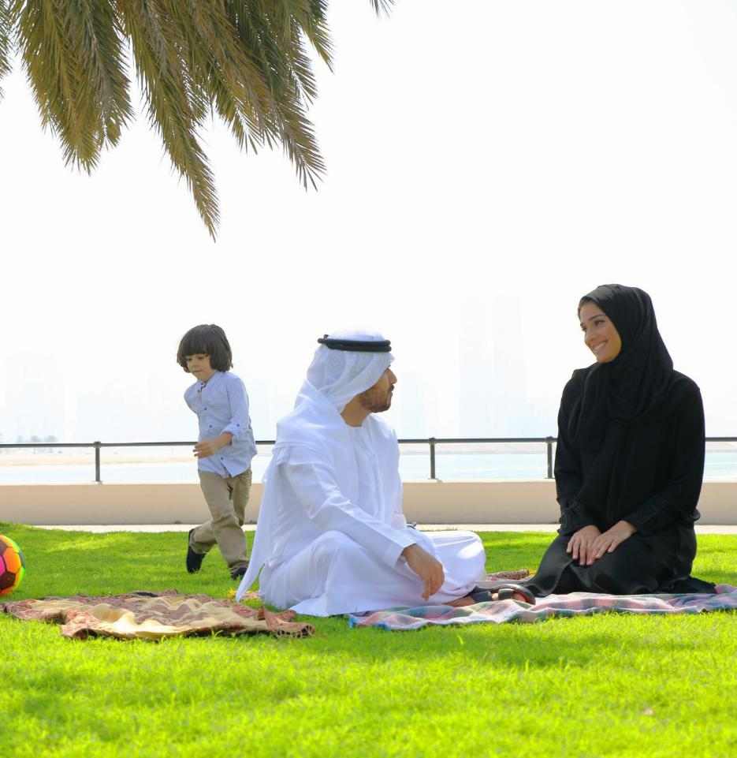
Agenda for Today
Introduction to Qatar National Sports Day
Activities and Events
Participation and Engagement
Impact on Society
Future of Qatar National Sports Day
Notes:
We will begin with an introduction to Qatar National Sports Day, including its history and objectives. Next, we'll explore the various activities and events that take place during this day. We will then discuss how different sectors participate and the positive impact this event has on society, concluding with the future plans for Qatar National Sports Day.

Slide 3
Introduction to Qatar National Sports Day
Notes:
Qatar National Sports Day is a key initiative aimed at fostering a culture of fitness and well-being. It serves as a reminder of the importance of integrating physical activity into our daily lives.

Slide 4

History and Inception
Launch of Sports Day
  Qatar National Sports Day was launched in 2012 to promote a culture of sports and physical activity among citizens and residents.
Encouraging Active Lifestyles
  The event encourages active lifestyles, emphasizing the importance of health and wellness in everyday life for all residents.
National Vision and Health
  Qatar National Sports Day reflects the nation's commitment to health and wellness, aligning with Qatar's broader national vision for a healthy society.
Notes:
Launched in 2012, Qatar National Sports Day was established to encourage citizens and residents to engage in sports and physical activities. The event reflects Qatar's commitment to health and wellness as part of its national vision.

Slide 5
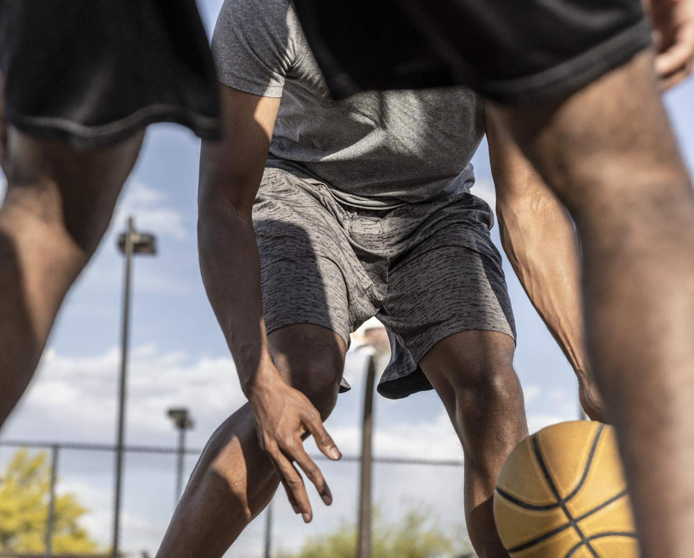
Purpose and Objectives
Promoting Healthy Lifestyles
  The main objective is to encourage individuals of all ages to adopt healthier lifestyles through active participation in sports.
Inspiring Sports Participation
  The event aims to inspire individuals to take part in various sports, fostering a culture of fitness and teamwork.
Enhancing Public Awareness
  Increasing public awareness regarding the importance of fitness and its impact on overall well-being is a key focus of the event.
Strengthening Community Bonds
  The event also aims to strengthen community ties by bringing people together in a fun and active environment.
Notes:
The primary goal of Qatar National Sports Day is to promote a healthy lifestyle among all demographics. The event aims to inspire individuals to participate in sports, enhance public awareness about fitness, and strengthen community bonds.

Slide 6
Activities and Events
Notes:
The day is filled with a diverse array of activities that cater to various interests and age groups, providing opportunities for everyone to engage in physical activities.

Slide 7
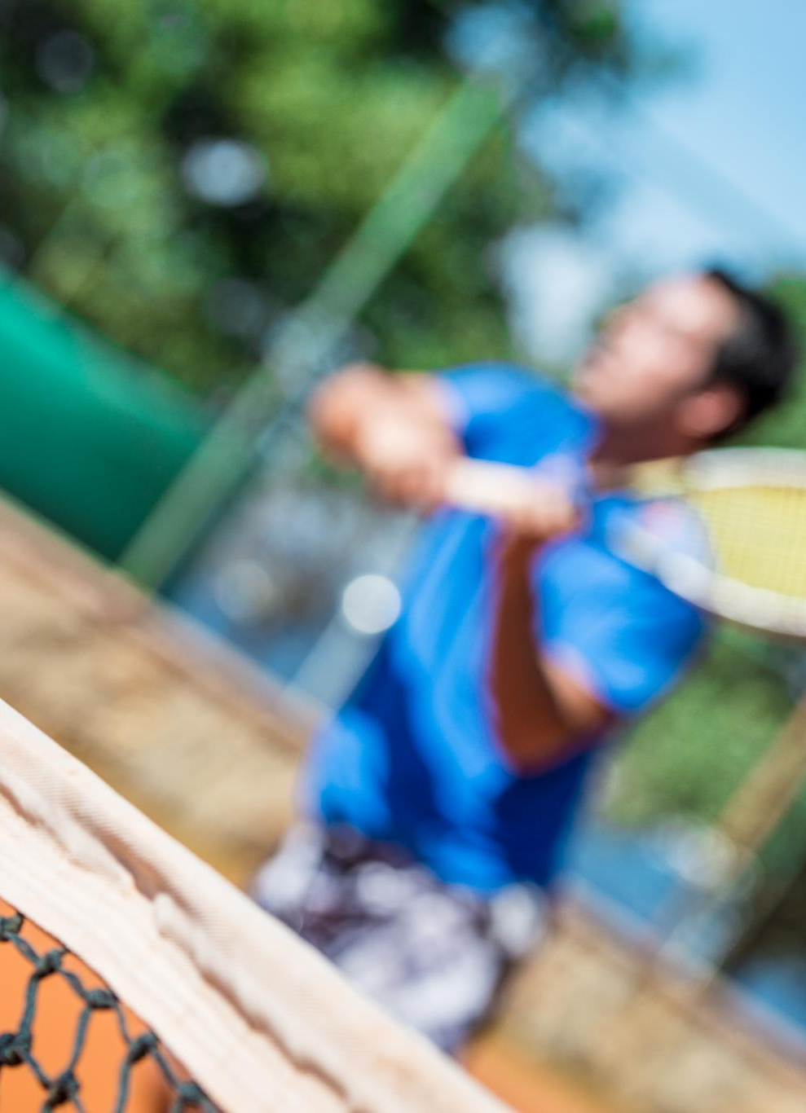
Sports Competitions
Traditional Qatari Games
  Traditional Qatari games reflect the rich cultural heritage and community spirit, showcasing unique skills and regional pride.
Team Sports
  Team sports play an important role in fostering collaboration and friendly competition among participants across various age groups.
Individual Challenges
  Individual challenges highlight personal achievements and skills, encouraging athletes to strive for excellence and personal growth.
Notes:
Various sports competitions are held throughout the country, including traditional Qatari games, team sports, and individual challenges. These competitions foster a spirit of friendly rivalry and promote teamwork.

Slide 8
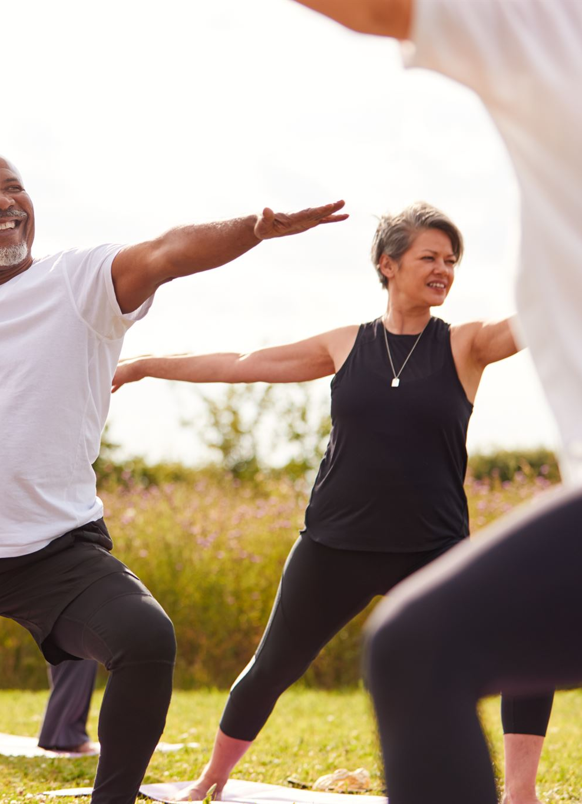
Fitness and Wellness Programs
Physical Health Benefits
  Fitness programs are designed to enhance physical health through regular exercise and various activities, leading to improved fitness levels and overall well-being.
Mental Well-Being
  Participating in fitness programs can significantly boost mental well-being, reducing stress and promoting a positive mindset through physical activity.
Social Interaction
  Fitness programs encourage social interaction among participants, fostering a sense of community and support through shared activities.
Notes:
Fitness programs such as yoga, aerobics, and running clubs are organized in public spaces. These initiatives focus on promoting physical health, mental well-being, and social interaction among participants.

Slide 9
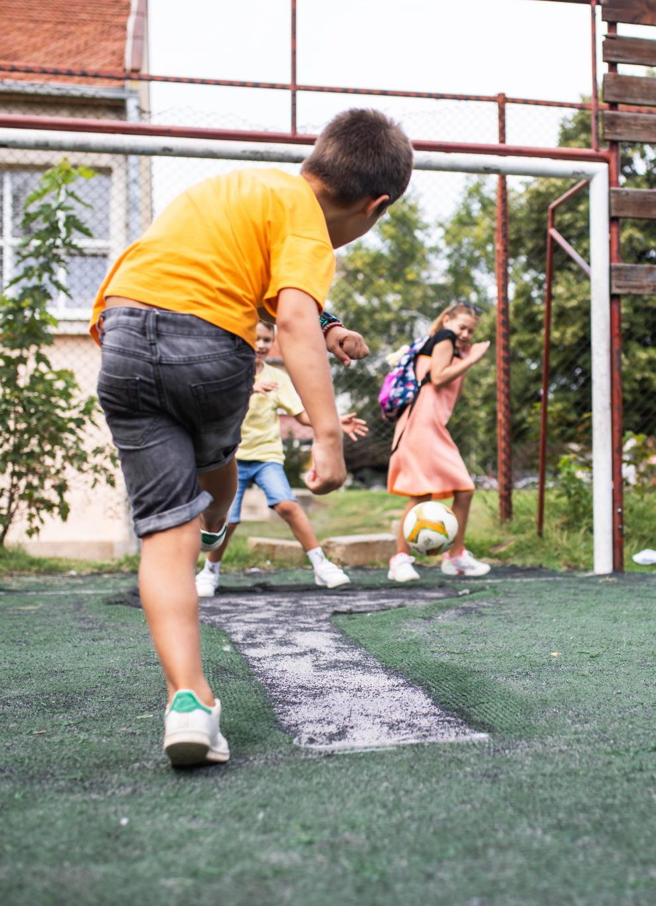
Community and Family-Oriented Events
Community Involvement
  Qatar National Sports Day focuses on encouraging community involvement through various sports and activities.
Family-Friendly Activities
  The event features family-friendly activities like fun runs and obstacle courses suitable for all age groups.
Fostering Belonging
  These activities aim to foster a sense of belonging and connection among community members.
Notes:
Qatar National Sports Day emphasizes community involvement. Family-friendly activities, such as fun runs, obstacle courses, and interactive games, encourage participation from all age groups, fostering a sense of belonging.

Slide 10
Participation and Engagement
Notes:
Engagement from various sectors of society is crucial for the success of Qatar National Sports Day. This section explores how citizens, schools, and organizations come together to celebrate health and fitness.

Slide 11

Involvement of Citizens and Residents
Community Participation
  The event encourages active participation from citizens and residents, promoting inclusivity and teamwork among community members.
Fostering Fitness Culture
  Through collective involvement in sports, the event helps promote a culture of fitness and healthy living within the community.
Building Camaraderie
  Engagement in sports activities fosters camaraderie and strengthens relationships among citizens, creating a sense of belonging.
Notes:
The event sees significant participation from citizens and residents, who are encouraged to engage in sports activities. This collective involvement helps foster a culture of fitness and camaraderie within the community.

Slide 12
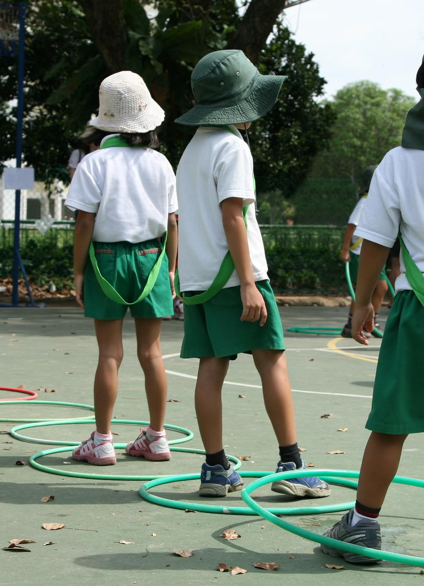
Role of Schools and Educational Institutions
Organizing Sports Days
  Schools play an essential role by organizing sports days, fostering a spirit of competition and celebration in students.
Encouraging Physical Activities
  Educational institutions encourage students to participate in physical activities, promoting a healthy and active lifestyle.
Promoting Health and Teamwork
  Through sports, educational institutions instill values of health, teamwork, and discipline, which are crucial for personal development.
Notes:
Schools play a vital role by organizing sports days and encouraging students to participate in physical activities. Educational institutions promote the values of health, teamwork, and discipline through sports.

Slide 13

Corporate and Organizational Participation
Employee Engagement Events
  Companies organize events to engage employees, fostering a sense of belonging and community within the workplace.
Health and Wellness Promotion
  Involvement in workplace activities enhances employee health and promotes overall well-being, leading to a happier workforce.
Community Building
  Organizing events helps to create a supportive community atmosphere, improving relationships among employees and fostering teamwork.
Notes:
Many companies and organizations participate by organizing events for their employees. This involvement not only enhances workplace health but also contributes to building a supportive community atmosphere.

Slide 14
Impact on Society
Notes:
The event has profound implications for societal health and well-being. This section highlights the positive changes brought about by Qatar National Sports Day.

Slide 15
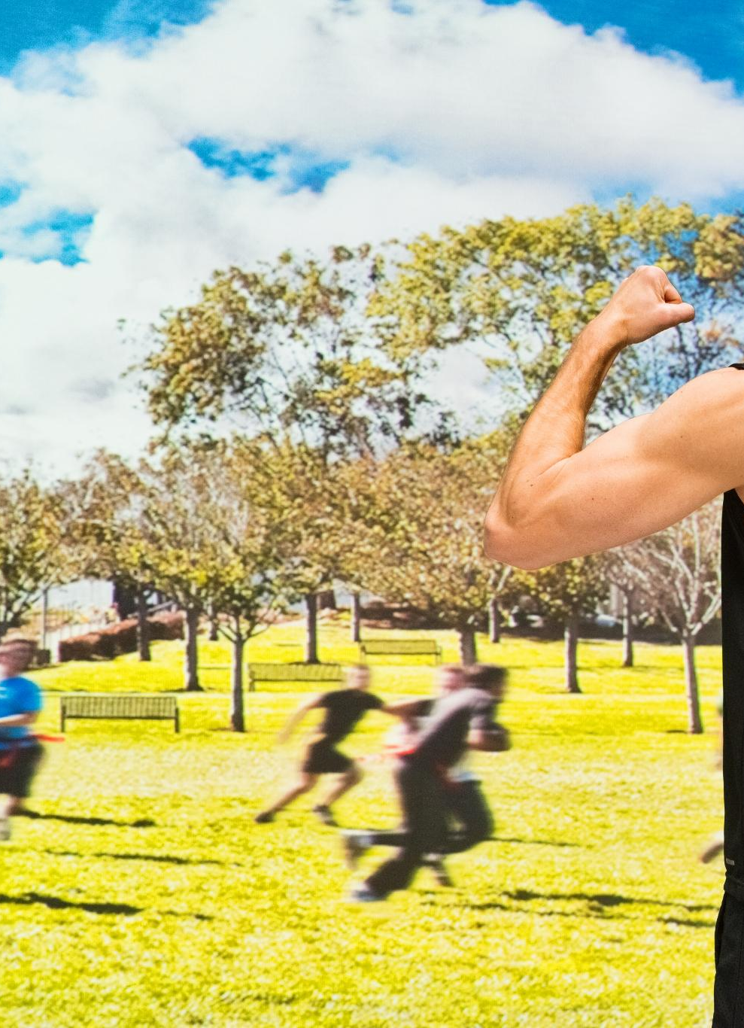
Promotion of a Healthy Lifestyle
Awareness of Health Benefits
  Qatar National Sports Day raises awareness about the numerous benefits of maintaining a healthy lifestyle through physical activity.
Encouragement for Fitness
  The event encourages citizens to prioritize fitness and integrate physical activities into their daily routines.
Community Participation
  National Sports Day fosters community spirit by involving residents in various sports and fitness activities together.
Notes:
Qatar National Sports Day significantly contributes to raising awareness about the importance of a healthy lifestyle. It encourages citizens to make fitness a priority in their daily lives.

Slide 16

Building Community Spirit and Unity
Celebrating Diversity
  The event brings together people from various backgrounds, promoting inclusivity and fostering community spirit.
Reinforcing Social Bonds
  Participants engage in activities that reinforce social connections and create lasting friendships within the community.
Promoting Health and Fitness
  The event emphasizes the importance of health and fitness, encouraging participants to adopt healthier lifestyles together.
Notes:
The event fosters community spirit as people from diverse backgrounds come together to celebrate health and fitness. It reinforces social bonds and creates a sense of unity among participants.

Slide 17
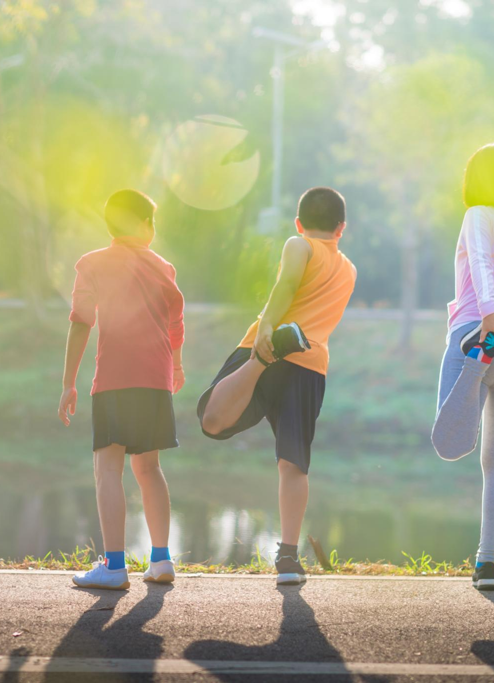
Long-Term Benefits for Public Health
Promotion of Physical Activity
  Promoting physical activity helps individuals maintain a healthy weight, reducing the risk of chronic diseases.
Healthy Living Initiatives
  Healthy living initiatives encourage nutritious eating and active lifestyles, which are vital for long-term health.
Enhancing Quality of Life
  Regular participation in physical activities enhances mental and physical well-being, contributing to a higher quality of life.
Notes:
By promoting physical activity and healthy living, Qatar National Sports Day contributes to long-term public health benefits, reducing the risk of lifestyle-related diseases and enhancing the overall quality of life.

Slide 18
Future of Qatar National Sports Day
Notes:
Looking ahead, Qatar National Sports Day is set to evolve with new initiatives that will continue to promote health and fitness within the community.

Slide 19

Plans for Future Events
Expanding Participation
  Future events will focus on strategies to attract more participants from diverse backgrounds and interests.
Innovative Activities
  Incorporating innovative activities will enhance engagement and draw in a wider audience, keeping the events exciting.
Relevance and Engagement
  Ensuring that future events remain relevant to current trends and interests will be a key focus area.
Notes:
Future events will aim to expand participation and include innovative activities that appeal to a wider audience, ensuring the event remains relevant and engaging.

Slide 20

Potential New Activities and Programs
Community-Centric Fitness Programs
  New fitness programs will be developed to align with the interests and needs of the community, encouraging participation and engagement.
Technology-Driven Fitness Solutions
  Incorporating technology in fitness solutions can enhance user experience and provide personalized training options for participants.
Unique Sports Activities
  Introducing unique sports activities will attract diverse participants and promote a more inclusive fitness environment.
Notes:
There is a focus on introducing new fitness programs and activities that cater to the interests of the community, including technology-driven fitness solutions and unique sports.

Slide 21
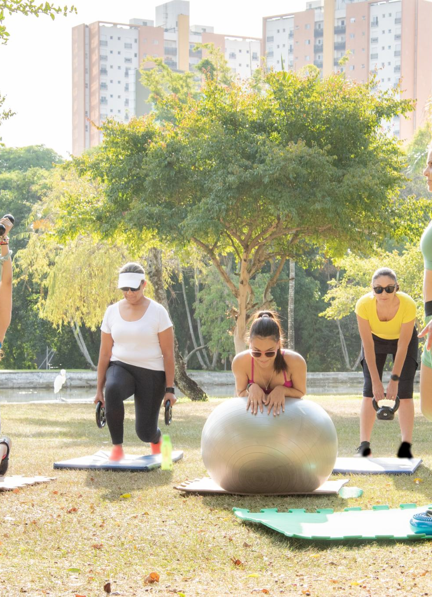
Continued Commitment to Health and Wellness
Ongoing Health Initiatives
  Government and community organizations are implementing continuous health initiatives to promote overall wellness throughout the year.
Sustained Culture of Fitness
  Creating a sustained culture of fitness requires ongoing engagement and resources to encourage healthy lifestyles among community members.
Community Collaboration
  Collaboration between government bodies and community organizations is vital for achieving long-term health and wellness goals.
Notes:
The government and community organizations are committed to promoting health and wellness beyond just one day. This ongoing dedication is essential for fostering a sustained culture of fitness.

Slide 22
Conclusion
Promoting Health and Fitness
Qatar National Sports Day promotes health and fitness, encouraging community members to engage in physical activities.
Rich History of Sports Day
The event has a rich history that highlights Qatar's commitment to health, sports, and community engagement.
Positive Community Impact
The positive impact of Qatar National Sports Day is evident in the increased awareness and participation in healthy lifestyle choices.
Notes:
Qatar National Sports Day serves as a vital platform for promoting health and fitness within the community. With its rich history, engaging activities, and positive impact, it plays a crucial role in shaping a healthier, more active society.

